Slide 1

2-D Adventure – Episode 01
Notes:
Today we’ll be creating the elements for a 2D style adventure game.

Slide 2
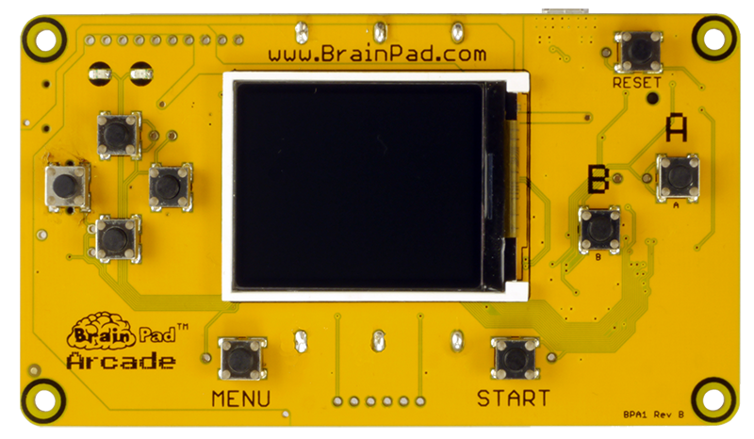
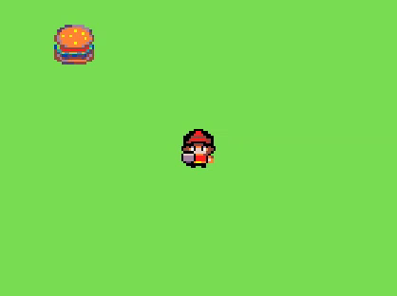
Let’s create a 2-D Adventure game.
Notes:
In this game we’ll create a character that can grab food on the screen.

Slide 3
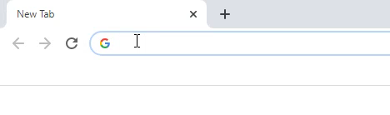
Open a web browser and navigate to…
arcade.makecode.com
Notes:
First open a browser window and navigate to arcade.makecode.com

Slide 4
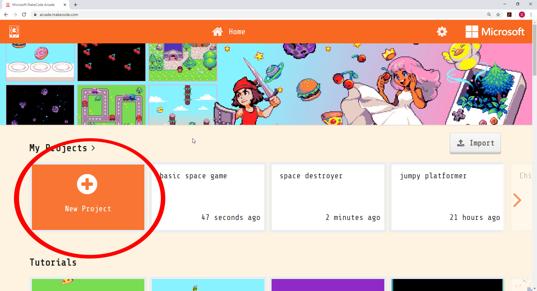
Notes:
Click on the ‘New Project’ Button, this will open a window to name our project and create a blank project for us to use.

Slide 5
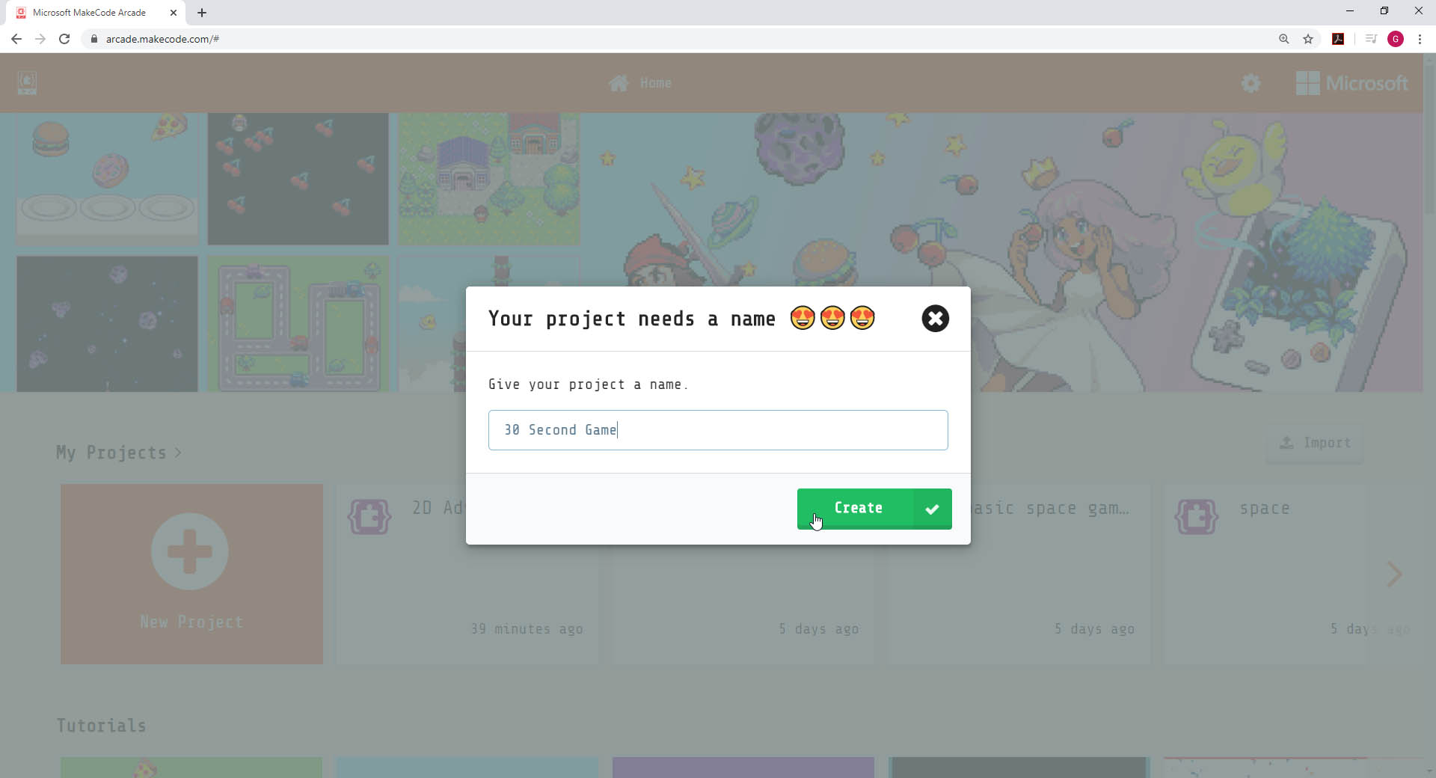
Notes:
Now let’s name the new project we’re about to create. We’ll call it ’30 Second Game’

Slide 6
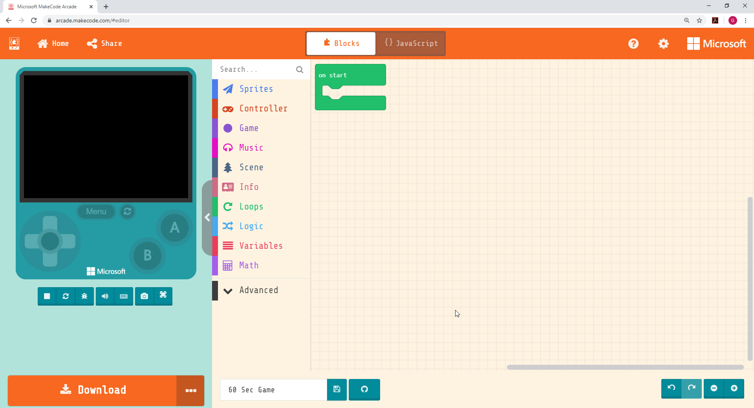
DESIGN SURFACE
This is where the game you
create will come to life!
Online Simulator
Block Menu
Online Simulator
Block Menu
Design Canvas
Download (for later)
Undo/Redo & Zoom
Design Canvas
Undo/Redo & Zoom
Download
Notes:
To change how to sprite looks, they will have to click on the white sprite box and then create their own sprite or use one from the gallery.

Slide 7


Computer Term:
SPRITE
A sprite is a two-dimensional image that is integrated
into a larger scene, most often in a 2D video game.
EXAMPLE:
Notes:
SPRITE….a sprite is a two-dimensional image that is integrated into a larger scene, most often in a 2D video game. A video game has many sprites. The player we move on screen is a sprite. Monsters or enemies that chase the player are sprites. Gold coins we might collect in a game are also sprites.

Slide 8
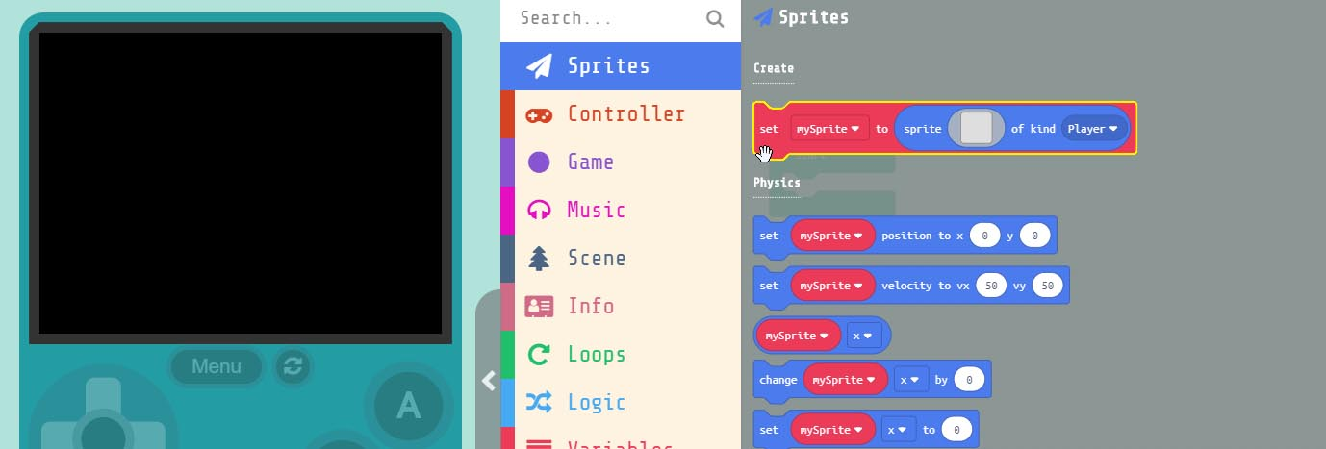
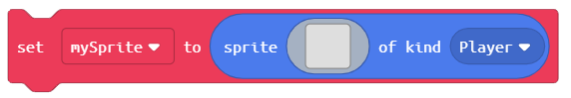
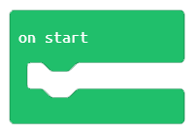
Grab the block
and drag it into the block
Notes:
Let’s create our first sprite. First we need to add a block to put our player ‘Sprite’ in. Under ‘Sprites’ in the menu, grab the ‘set mySprite to’ block and drag it into the ‘on start’ block that is already in our work area.

Slide 9
Computer Term:
VARIABLE
A variable is a letter or word, such as “x” or “score”
that represents a changing value. Variable can be named
anything but should be meaningful. To make code easier to read.
EXAMPLE:
score=score + 1
Notes:
Variable….a variable is a letter or word, such as ‘x’ or ‘score’ that represents a changing value. Variables within a program will always be changing. We can name variables what ever we want, but they should use meaningful names, so that when reading our code we better understand what’s happening inside of it. An example of a good variable name would be ‘score’. What do you think the variable ‘score’ represents? What do you think the variable ‘score’ would equal when we first start our game?

Slide 10
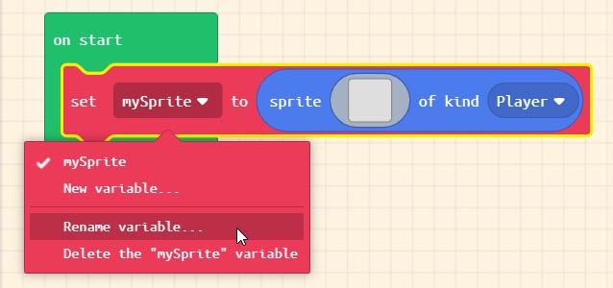
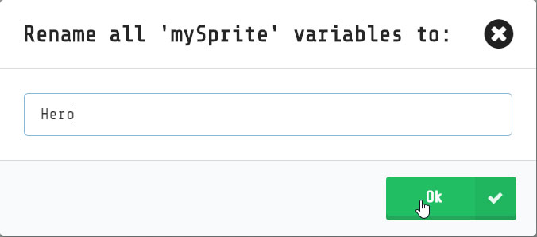
Naming our first ‘variable’
Rename ‘mySprite’
to ‘Hero’
Notes:
Now let’s rename ‘mySprite’ to something more meaningful Since we’re making a space shooter game lets name the player ‘Hero’. We do this by clicking on the DOWN arrow next to the word ‘mySprite’. Variables should always have meaningful names and not the ‘default’ names. What do you think the new variable we just created is going to represent in our program?

Slide 11
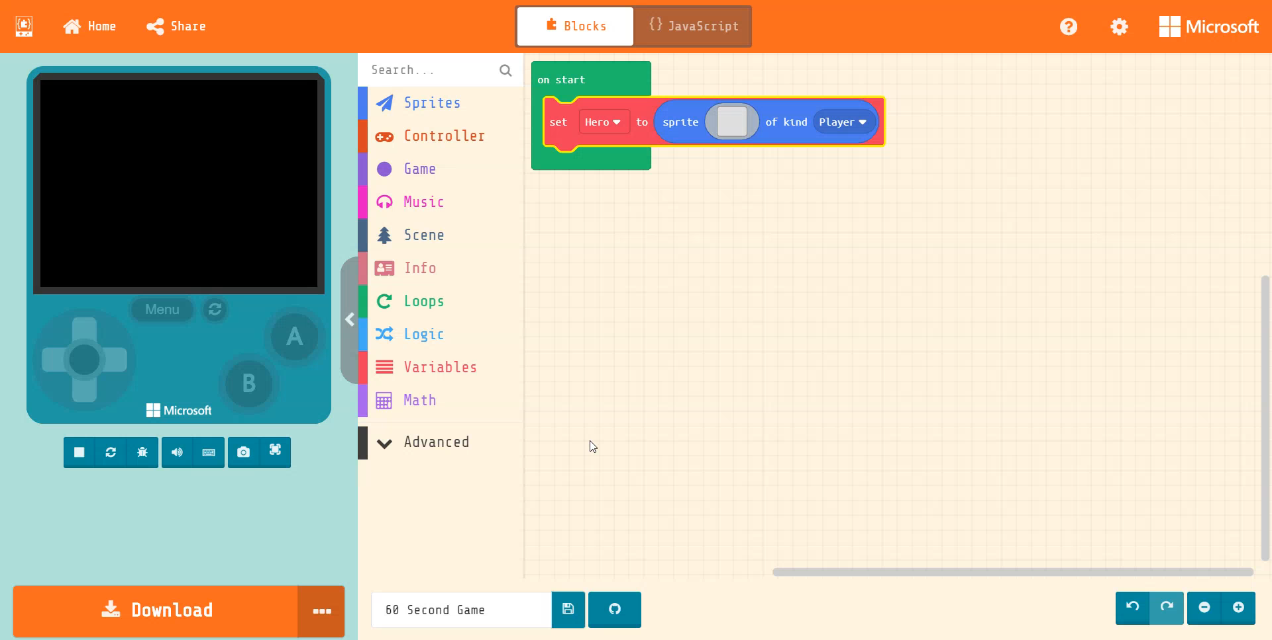
Notes:
Now let's add our ‘Hero’ sprite to the block. To do this click on the blank gray box inside the ‘set Hero to’ block. This will bring up the Sprite editor. This is where Sprites are created or selected. We will grab one of the pre-created Sprites from the ‘Gallery’. Click on gallery and scroll down until you see one of the ‘Hero Characters’ select it and press ‘DONE’

Slide 12
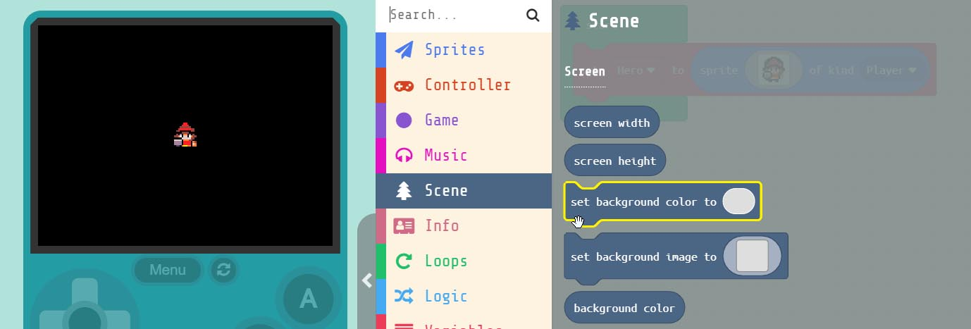
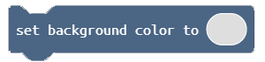
Grab the Block
and drag it into the block just below our ‘Hero’
Notes:
Our ‘Sprite’ is on a black background and we can’t see his feet, so lets change the background color. Under ‘Scene’ in the menu grab the ‘set background color to’ block and drag it into the ‘on start’ block in the work area.

Slide 13
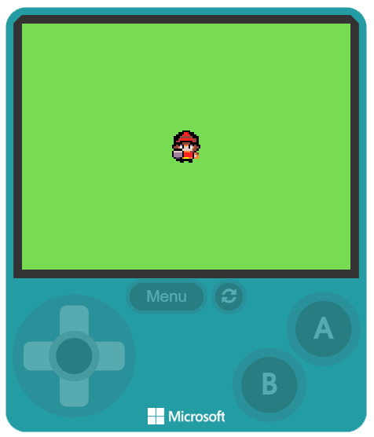
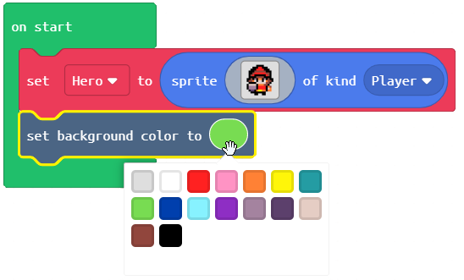
Click inside the GREY circle
and select the color GREEN
Notes:
Next, click on the GREY circle inside the block we just added. This will open up a color palette, select the color green. Now our ‘Hero’ is standing on field of green grass.

Slide 14
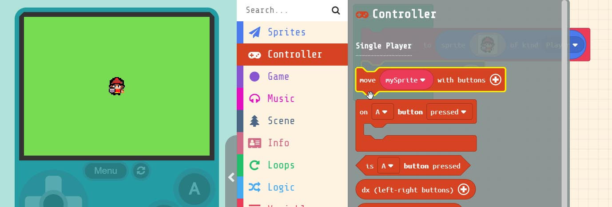
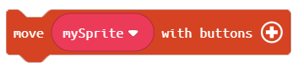
Grab the . block
Drag it into the block just below the other blocks
Notes:
Now lets move our Sprite around the screen. Under ‘Controller’ in the menu select the ‘move mySprite with buttons’ block drag it into the ‘on start’ block just below the other blocks.

Slide 15
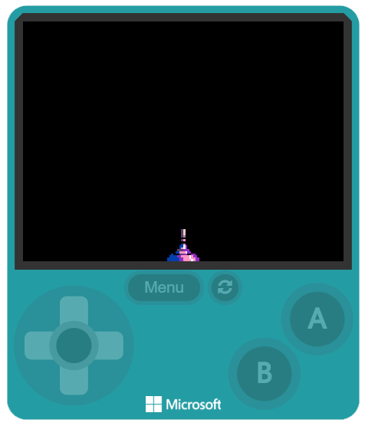
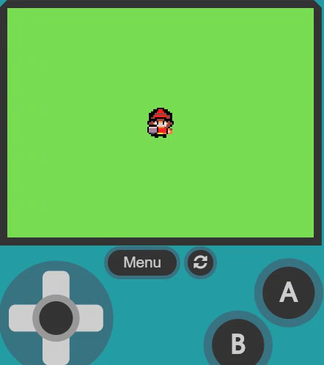
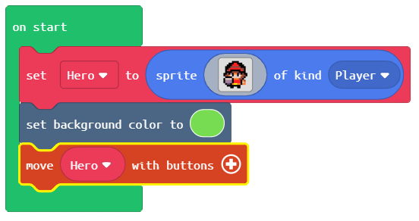
Change the name to ‘Hero’
Now we can move our Sprite
around the screen
You’ll notice the ‘Hero’ leaves
the screen
Notes:
First, we need to set it to control our Sprite by changing the name from ‘mySprite’ to ‘Hero. Try it in the simulator. You may notice that the ship can go right off the screen. We can fix that.

Slide 16
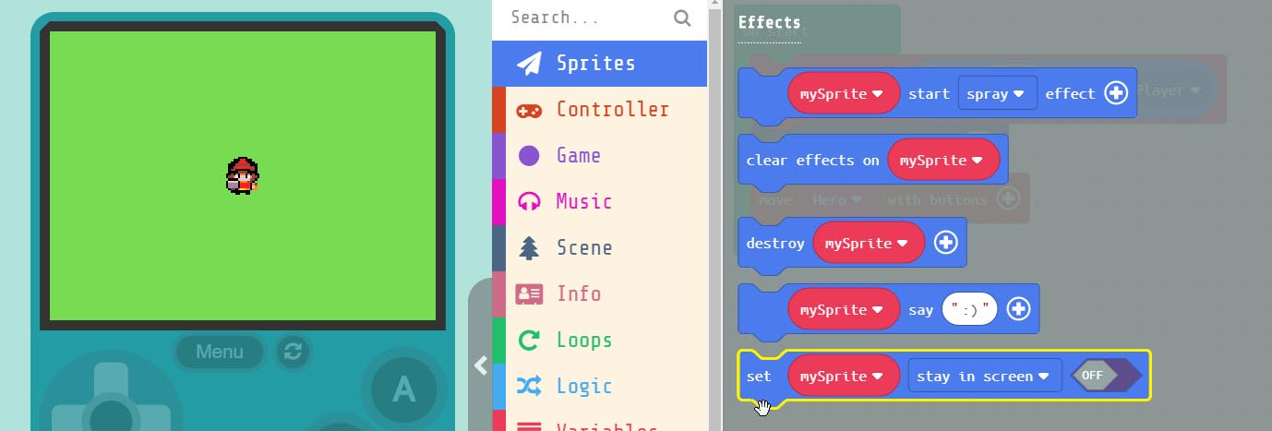
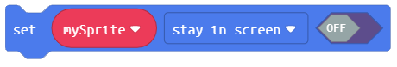
Grab the . Block
drag it into the block just below the other blocks
Notes:
Under ‘Sprites’ in the menu, scroll down to the ‘set mySprite stay in screen’ block and drag it into the bottom of the ‘on start’ block.

Slide 17
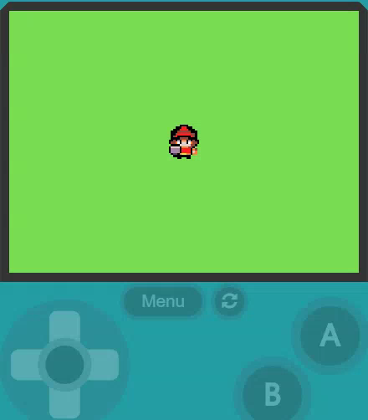
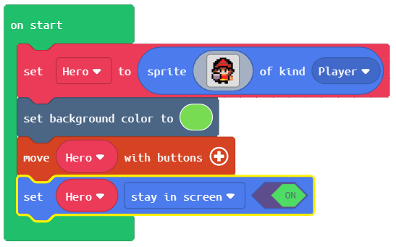
Change the name to ‘Hero’
and set the block to ‘ON’
Now our ‘Hero’ stays on screen
Notes:
Again, we’ll need to change the name to ‘Hero’ in order to attach the blocks action to our specific Sprite. We also must turn the block ‘ON’. Now when you move to the edge our ‘Hero’ stops and won’t go off the screen.

Slide 18
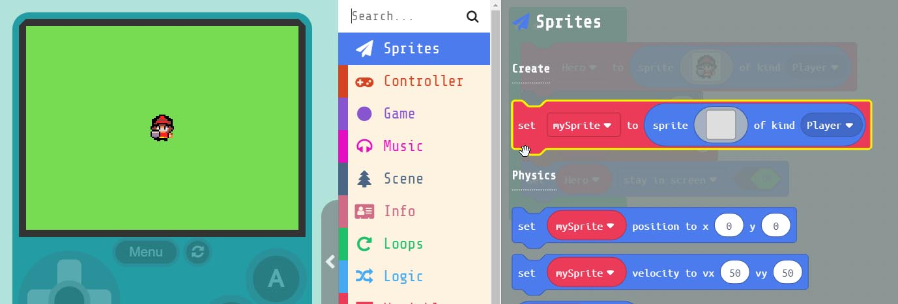
Grab the Block
drag it into the block just below the other blocks
Notes:
Let’s add something for our ‘Hero’ to eat. To do this we need to grab another ‘set mySprite to’ block. Just like we did when we created our ‘Hero’ and drag it into the ‘on start’ block at the bottom.

Slide 19
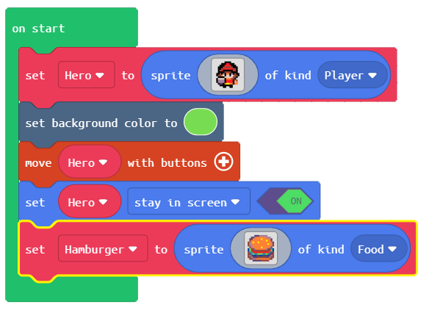
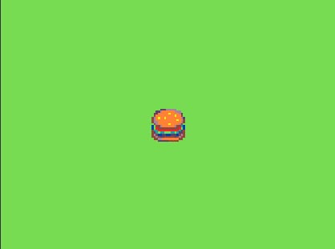
Change the name to ‘Hamburger’
change the ‘kind’ to ‘Food’
By default our Hamburger Sprite
appears in the center of the screen
Notes:
From the gallery select the image of the Hamburger. We also need to change our variable name to ‘Hamburger’ and its ‘kind’ to ‘Food’. After we do this our ‘Hamburger’ Sprite by default appears in the middle of the screen on top of our ‘Hero’

Slide 20
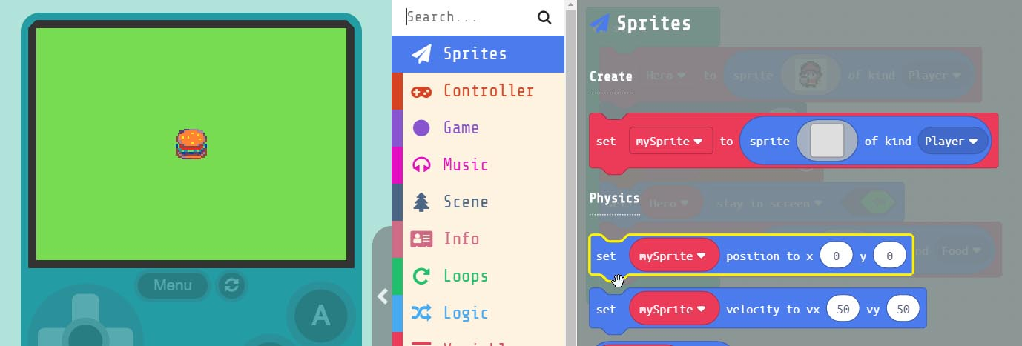
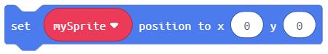
Grab the block
drag it into the block just below the other blocks
Notes:
Let’s put the ‘Hamburger’ somewhere else on the screen. To do this we need to grab the ‘set mySprite position’ block and drag it into the ‘on start’ block.

Slide 21
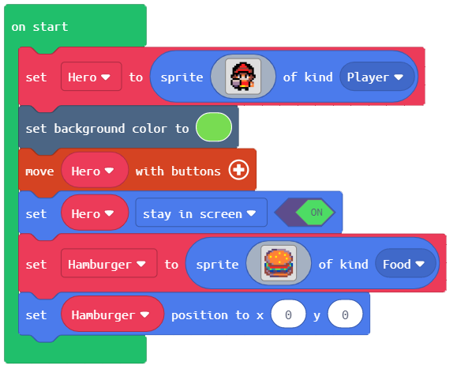
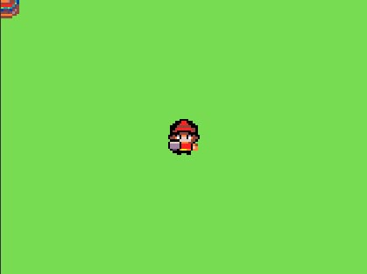
Change the name to ‘Hamburger’
change the ‘kind’ to ‘Food’
By default our Hamburger Sprite
now appears in the top corner
Notes:
We need to change the variable name in the new block we just added to ‘Hamburger’. You’ll notice now our ‘Hamburger’ is in the top left corner of our screen. That’s because the ‘x’ and ‘y’ parameter are both 0.

Slide 22
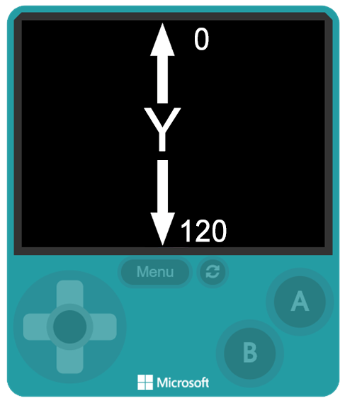
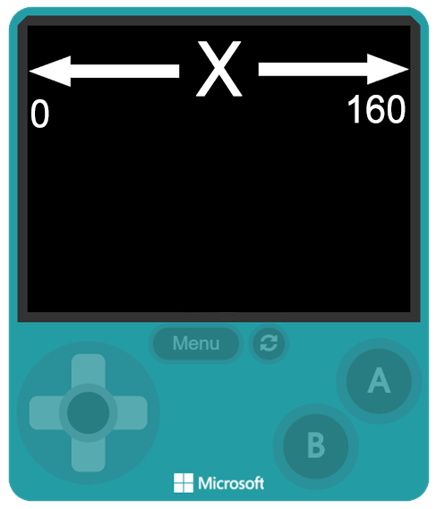
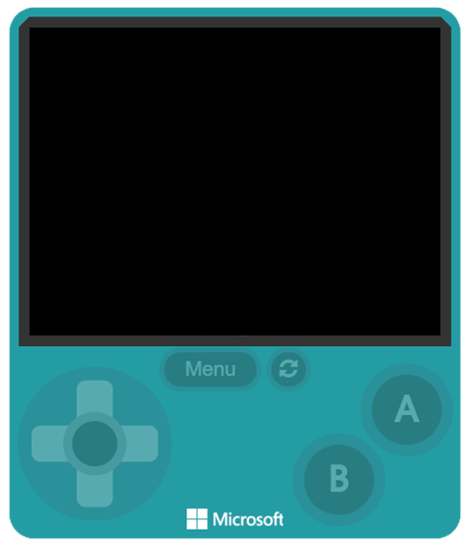
The x & y
parameters
represents
pixels on
the screen
Notes:
When we talk about the ‘x & y’ parameter? What does the x and y mean? These are pixels on the screen. The display is 160x120, which means our display consists of 19200 individual pixels. We use the x and y to define exact pixels on the screen. The x parameter starts on the LEFT at ZERO and goes all the way to the right at 160. y reads top to bottom, with the top pixel of y = 0 and the bottom pixel of y= 120. These parameters help us place and move our Sprites around the screen.

Slide 23
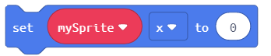
Computer Term:
PARAMETER
A parameter is a value that we add inside a block.
This number is passed into the block. In the example
block below ‘0’ would be the parameter. Parameters can
also be referred to as 'ARGUMENTS'
EXAMPLE:
Notes:
Parameter, a parameter is a value we add inside a block. Parameters are also sometimes called ‘Arguments’ . This number is passed into the block. In the example here ‘0’ is the parameter. Some blocks can contain multiple parameters. The one is this example only contains 1.

Slide 24
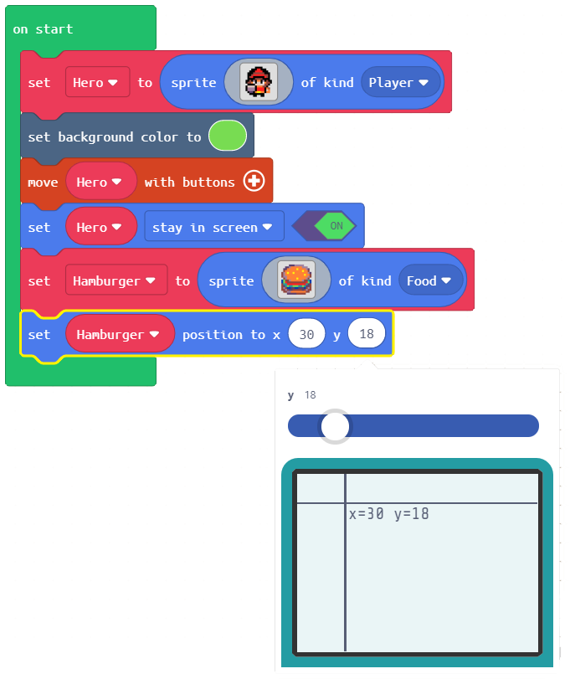
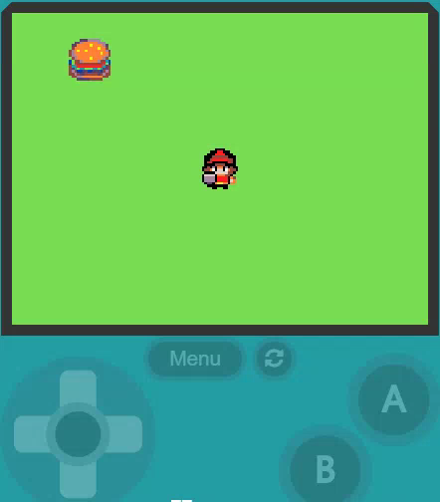
Click on either
the x or y parameter
and set the position
of the ‘Hamburger’
Notes:
Click on either the x or y parameter, a slider will pop up and you can use this to position where you want the hamburger to appear on the screen. You can also set the x and y parameters manually by typing in a number directly. Hint remember the x and y of the screen x is between 0 -160 for and y is between 0-120 . Trying moving our ‘Hero’ and grab the ‘Hamburger’. You’ll notice nothing happens. We need to add collision detection ‘EVENT’

Slide 25
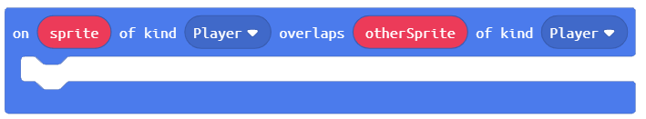
Computer Term:
EVENT
An event is an action or occurrence detected by a program.
Events can be a user action like clicking a button or when
Sprites overlap.
EXAMPLES:
Notes:
Now you may have noticed that ‘on sprite of kind Player overlaps’ block looks different then the other blocks. It looks more like the ‘on start’ block, like a square. This is because it’s what is known as an ‘EVENT’ block. An ‘EVENT’ block runs the code we place inside of it when an ‘EVENT’ occurs. Like when Sprites overlap. ‘on start’ is an ‘EVENT’ too. The first time we run our program, everything inside of it runs at start up.

Slide 26
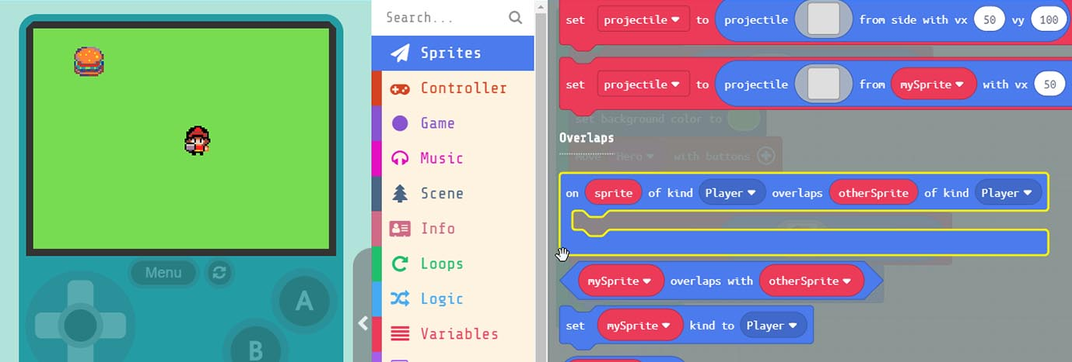
Grab the Event block
drag it into workspace.
Notes:
Under ‘Sprites’ in the menu select the ‘on sprite of kind player overlaps with otherSprite’ Event block. Remember that events are standalone blocks that run the code inside them when something happens. In this case when we have an overlap of Sprites.

Slide 27
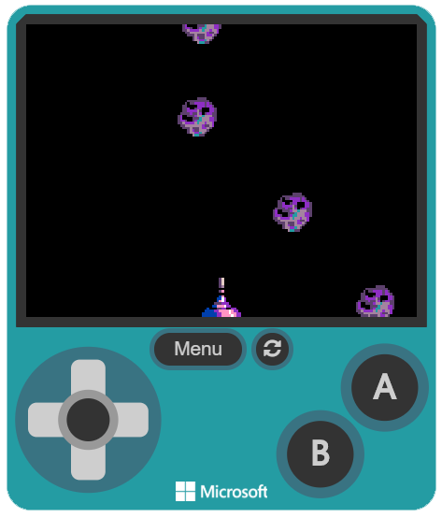
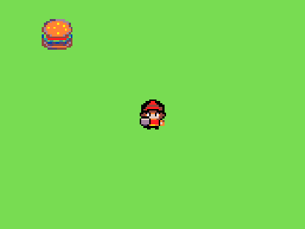
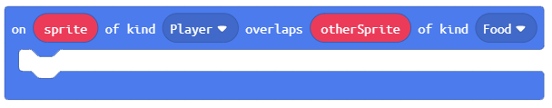
Now let’s change the parameters
inside our ‘overlap’ block.
We can leave the first kind
to ‘Player’ but change
the last kind to ‘Food’
Notes:
We need to change the kind of Sprites we want to detect when overlapping. We can leave the first ‘kind’ as ‘Player’, next change the last kind from ‘Player’ to ‘Enemy’. So now when a ‘Player’, our ‘Hero’, overlaps a Sprite type ‘Food’, our ‘Hamburger’, the code we place inside this block will run.

Slide 28
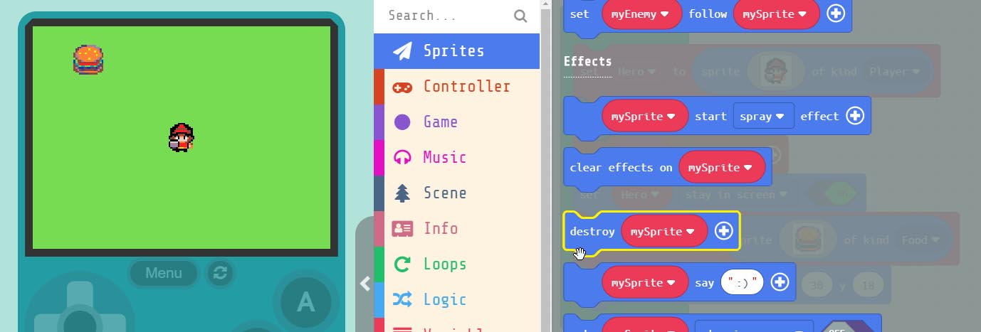
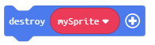
Grab the block.
Put inside our Event block.
Notes:
Under ‘Sprites’ in the menu select the ‘on sprite of kind player overlaps with otherSprite’ Event block. Remember that events are standalone blocks that run the code inside them when something happens. In this case when we have an overlap of Sprites.

Slide 29
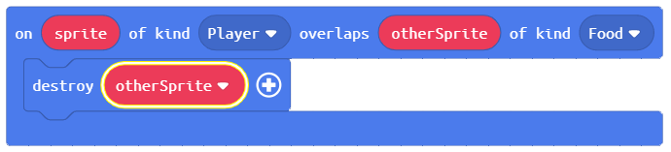
We need to create a ‘NEW’
variable called ‘otherSprite’
This ensures that every time our
‘Hero’ overlaps the ‘otherSprite’
that is of kind ‘Food’ we eat it.
Notes:
We need to create a new variable by clicking the down arrow inside the ‘destroy mySprite’ block arrow. Name the new variable ‘otherSprite’. This ensures that every time our ‘Player’ overlaps the ‘otherSprite’ that is an “Food’ the ‘otherSprite’ will be destroyed. You ask, why we don’t set this to destroy ‘asteroid’ instead? We do this incase we have multiple Sprites on the screen. If we name a specific Sprite, then only that Sprite will trigger the ‘Overlap Event’ and nothing else.

Slide 30
Hardware Break
Now let’s load what we have on to the BrainPad.
Notes:
Now let’s load what we have so far on the BrainPad.

Slide 31
EXTRA
CREDIT
Notes:
During the EXTRA CREDIT section students are shown a snippet of JavaScript Code. They must decide which block in their program the snippet represents.

Slide 32
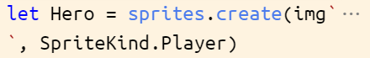
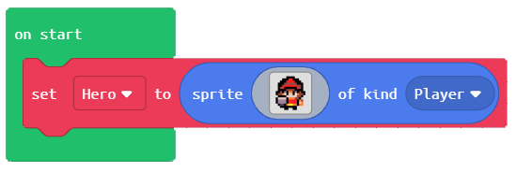
Code to Blocks:
JavaScript:
Block:

Slide 33
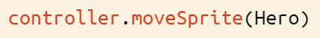
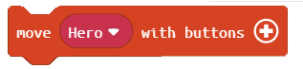
Code to Blocks:
JavaScript:
Block:

Slide 34
Code to Blocks:
JavaScript:
Block:

